Slide 1

ML 24/25-10 Creating Text from images with OCR API
Team : TechTitans
Mithila Prabhu ( 1567111)
Taibaz Pathan (1564714)
Khushal Singh (1564813)
Notes:
© Copyright PresentationGO.com – The free PowerPoint and Google Slides template library

Slide 2
Table Of Contents
01
04
Objective
Implementation
02
05
Introduction
Result
03
06
Methodology
Conclusion

Slide 3
1. Objective
The objective of the project “Creating Text from Images with OCR API” is to develop a console application using the Tesseract SDK for efficient text extraction from input images.
The primary goal is to identify the most effective image preprocessing technique among various available methods to enhance OCR accuracy.
Additionally, the project evaluates the impact of different preprocessing approaches on text extraction quality by comparing their effectiveness.

Slide 4
2. Introduction
Optical Character Recognition (OCR) is a technology that converts printed or handwritten text from images into machine-readable text. It is widely used for document digitization, automated data entry, and text extraction. The accuracy of OCR depends on factors such as image quality and preprocessing techniques like resizing, noise removal, and contrast enhancement. By optimizing these steps, OCR performance improves, making it more effective for various real-world applications.
Tesseract OCR is an open-source software that converts scanned documents, PDFs, and images into editable text. Developed by HP and maintained by Google, it supports over 100 languages and uses machine learning for accurate text recognition. It can handle complex layouts and noisy images, making it versatile for a variety of applications. Tesseract is widely used for document processing, text extraction, and digitizing information in both commercial and research fields.
Notes:
© Copyright PresentationGO.com – The free PowerPoint and Google Slides template library

Slide 5
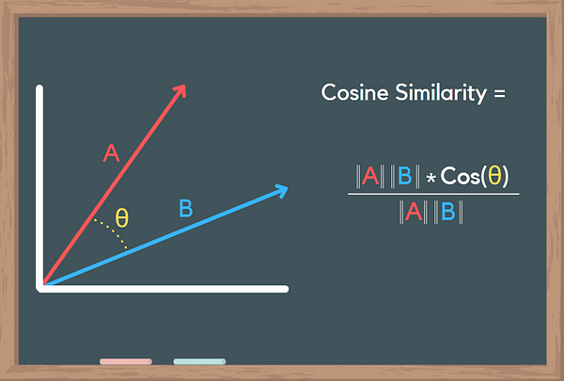
2. Introduction
Cosine similarity measures the similarity between two vectors by calculating the cosine of the angle between them. It’s commonly used in text analysis and NLP to compare documents or word embeddings. The value ranges from -1 to 1, where 1 indicates identical vectors, 0 means no similarity, and -1 represents opposite vectors. It’s especially useful for comparing documents of different lengths and is widely applied in tasks like document classification and recommendation systems.

Slide 6
2. Introduction
Embeddings represent high-dimensional text data as lower-dimensional vectors, making it easier to analyze and compare extracted text. In this project, text embeddings are generated from OCR-extracted text using a pretrained embedding model. These embeddings help in evaluating the effectiveness of different image preprocessing techniques by capturing semantic relationships in the extracted text. Cosine similarity is used to compare embeddings, allowing for an objective assessment of text quality. This approach is crucial for analyzing OCR accuracy and improving text recognition in real-world applications.
A similarity matrix represents pairwise similarity between a set of objects, with each element showing how similar two objects are. It's commonly used in machine learning, clustering, and recommendation systems, using metrics like cosine similarity or Pearson correlation. The matrix is symmetric, with diagonal elements typically showing maximal similarity .
6

Slide 7
3. Methodology
3. Apply Preprocessing Techniques
4. Extract Text using Tesseract OCR
1. Create a Blank Text File
2. Load Input Images
Grayscale, Adaptive Thresholding and save the transformed image.
store it in a text file and dictionary.
for storing extracted text.
For Processing
6. Generate Embeddings
using the text-embedding-ada-002 model via ChatGPT API.
5. Track Time and Memory Usage
7. Compute Cosine Similarity
for preprocessing and OCR.
and store results in Excel.
8. Evaluate preprocessing techniques
9. Save final results
based on similarity scores, time, and memory usage.
based on cosine similarity, time tracking, and memory usage, and save the final results in an Excel file.
Notes:
© Copyright PresentationGO.com – The free PowerPoint and Google Slides template library

Slide 8
4. Implementation
Image Preprocessing Techniques
Convert images to grayscale.
Apply Adaptive Thresholding
Apply Global thresholding.
Adjust Saturation.
Apply De-skew processing to images.

Slide 9
Performance Evaluation Metrics
Calculate Average Cosine similarity across all models. Exclude the diagonal values (which are always 1 because they represent self-similarity).
Cosine Similarity : normalizedCoSim = similarityScore / maxSimilarity
Execution Time : normalizedTime = 1 - (timeTaken / maxTime)
Memory Usage : normalizedMem = 1 - (memoryUsage / maxMemory)
Final Score=(0.5×normalizedCoSim)+(0.3×normalizedTime)+(0.2×normalizedMem)
50% importance to similarity score. 30% to execution time. 20% to memory usage.

Slide 10
5. Results
Comparison of different preprocessing techniques.
Demonstration of extracted text from sample images.

Slide 11
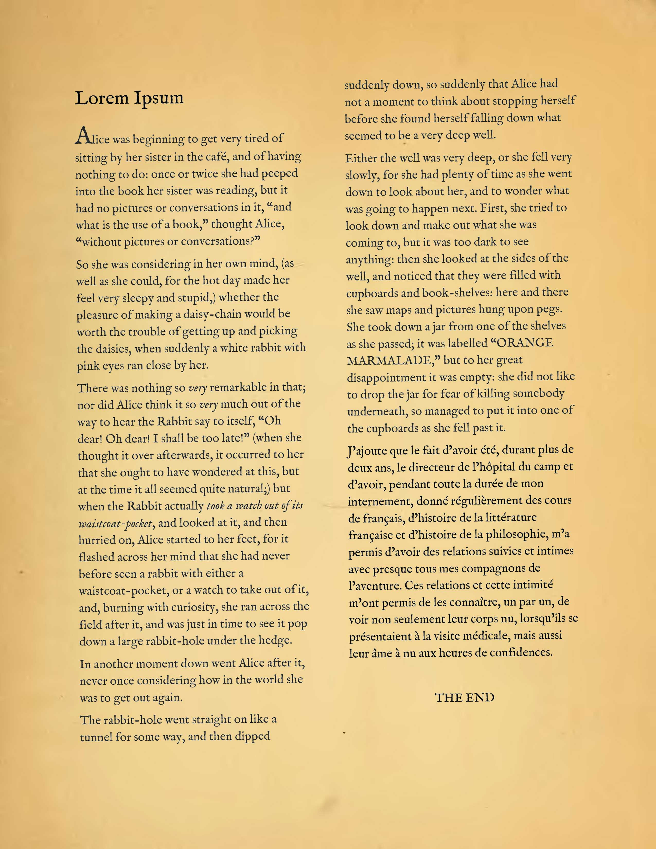
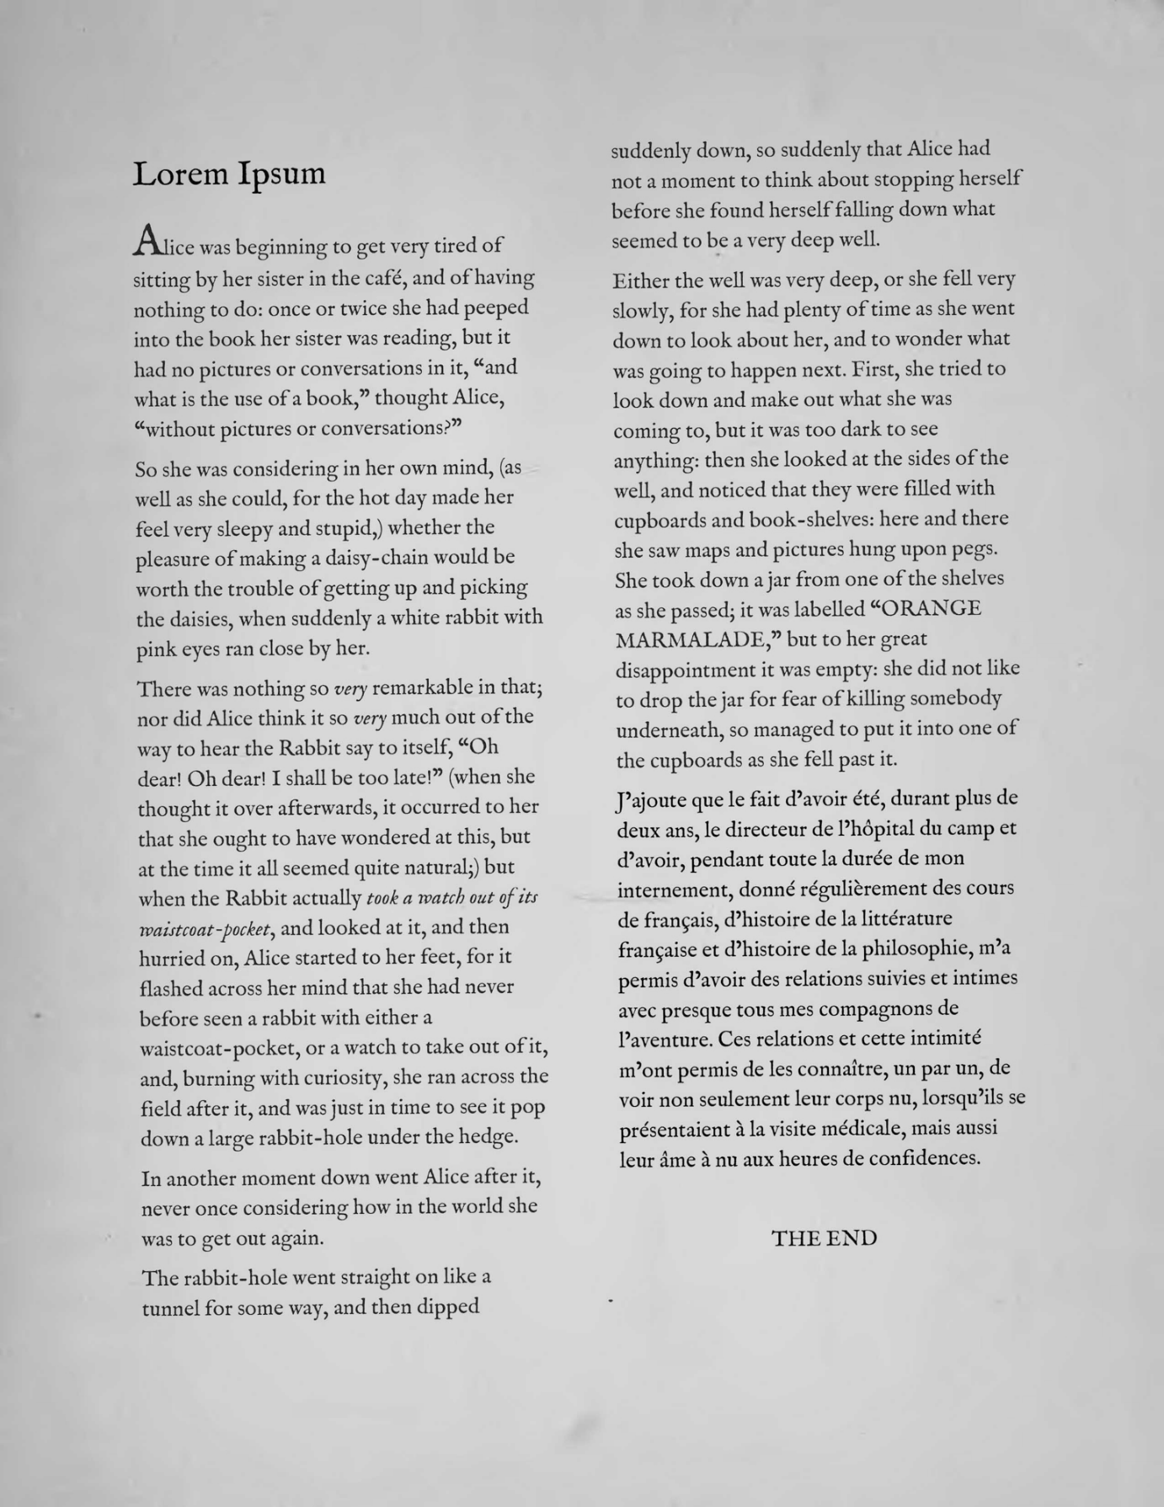
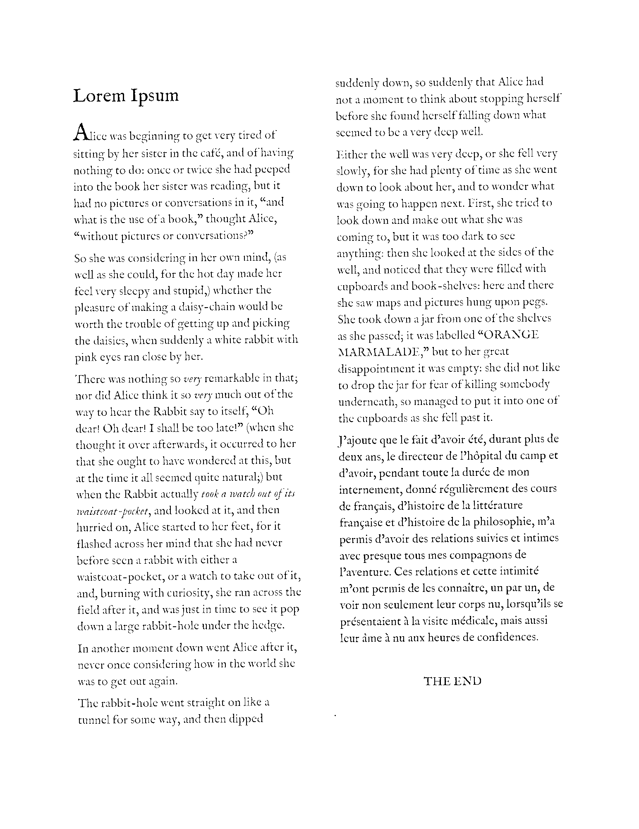
Preprocessed Images
Input Image
After Converting to Grayscale
After Global Thresholding at 80

Slide 12
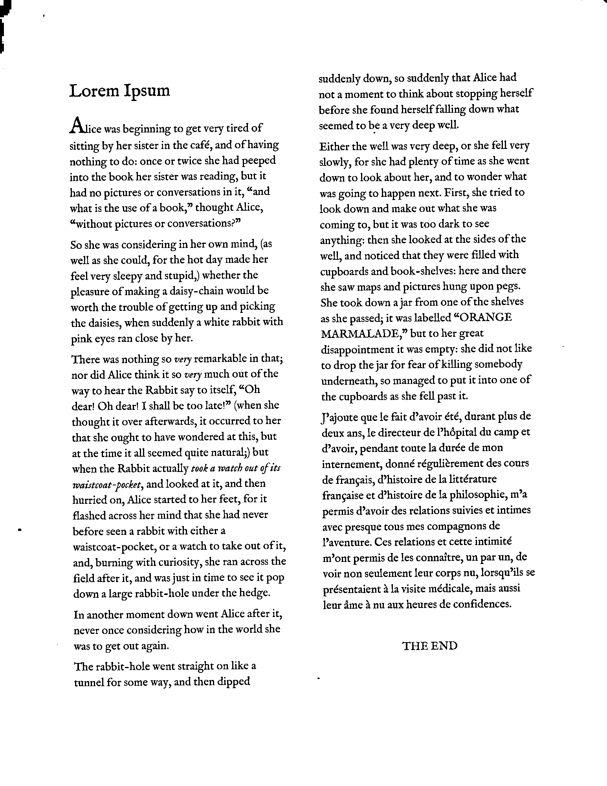
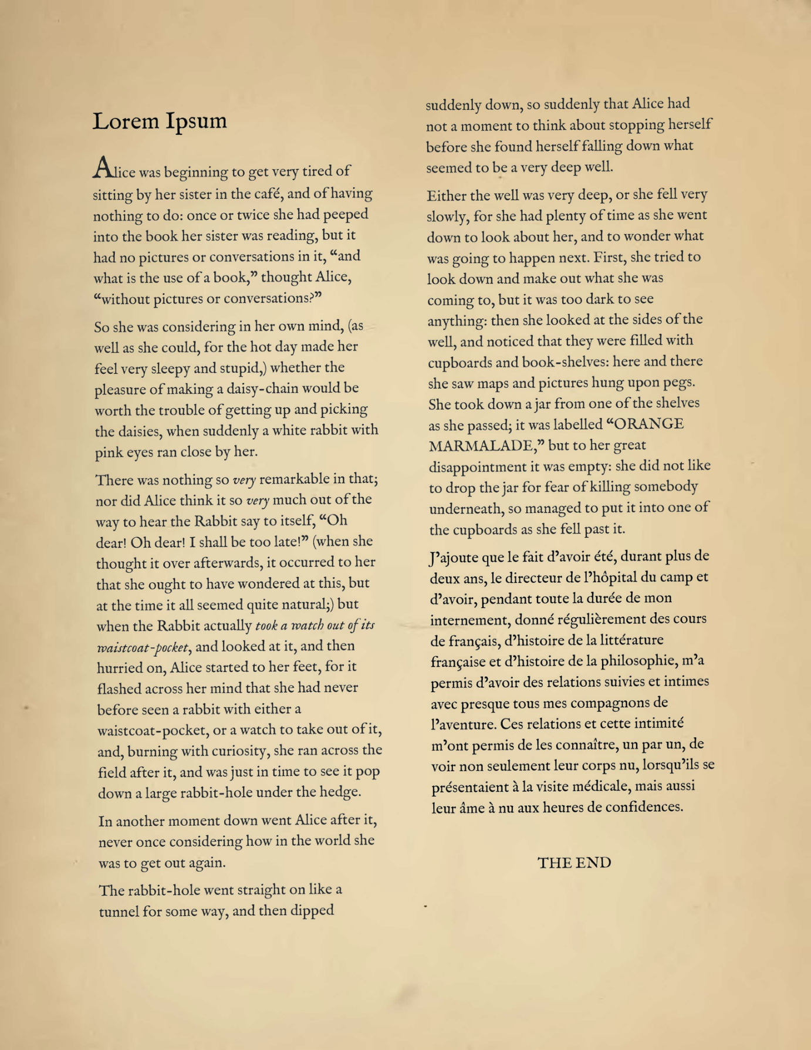
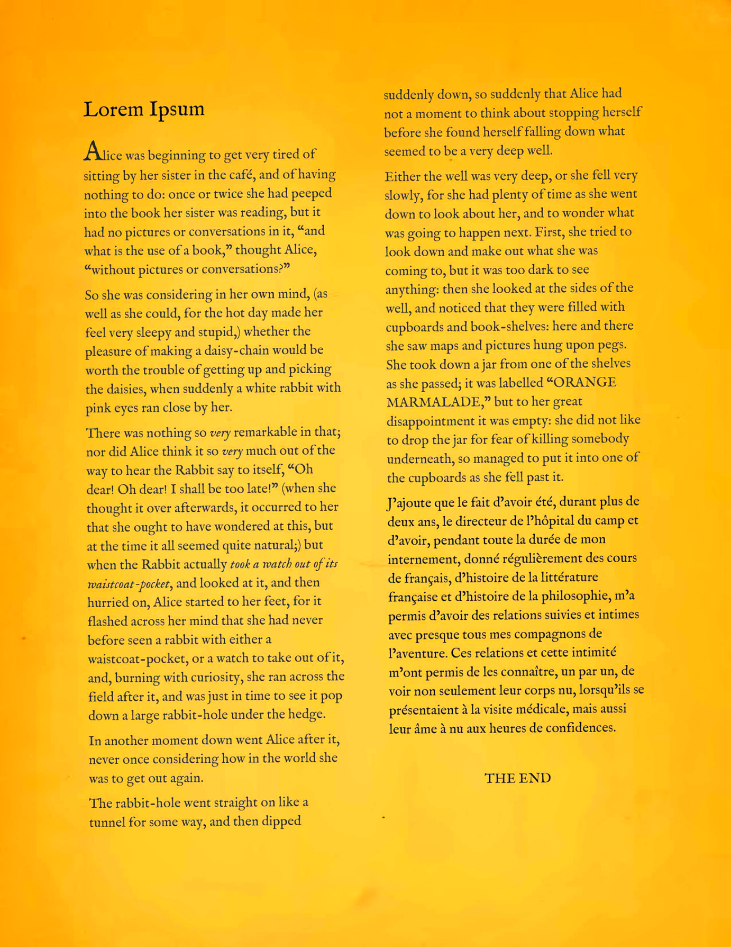
Preprocessed Images
Global Thresholding at 150
Saturation adjustment at 0.6
Saturation Adjustment 2.5

Slide 13
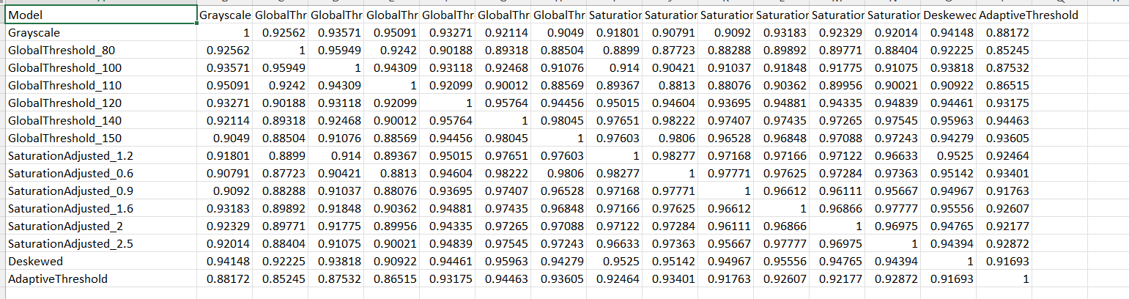
Similarity matrix

Slide 14
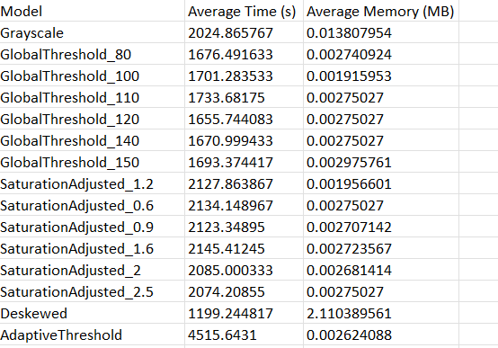
Time Tracking and Memory Usage Details

Slide 15
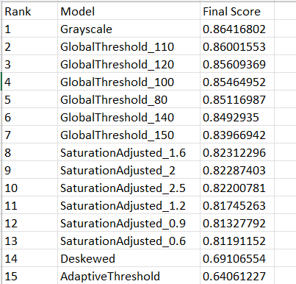
Model Evaluation

Slide 16
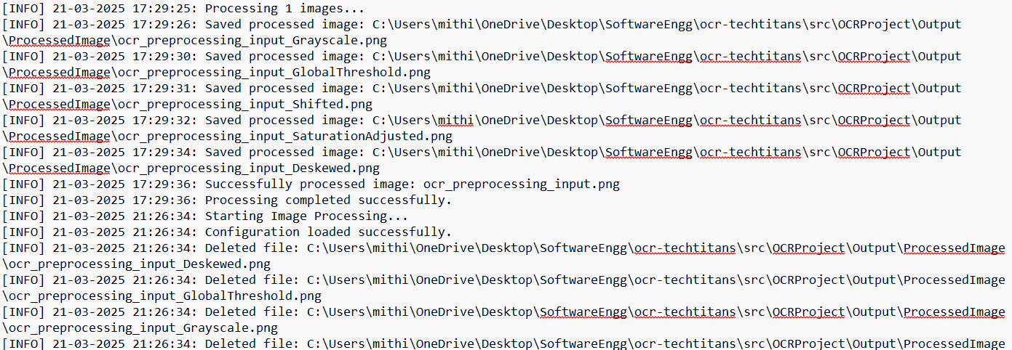
Log File

Slide 17
6. Conclusion
The project demonstrates the effectiveness of OCR in text extraction by analysing the impact of various preprocessing techniques on accuracy. Time and memory tracking provide insights into computational costs, while evaluation using cosine similarity ensures a comprehensive assessment. The results emphasize the importance of preprocessing in enhancing OCR accuracy and efficiency, making the system more reliable for real-world applications.

Slide 18
Future Work
Enhancing Preprocessing Techniques – Implementing advanced methods such as deep learning-based image enhancement and adaptive thresholding to further improve text recognition.
Integration with Other OCR Models – Exploring and comparing different OCR engines to analyse their effectiveness with varied preprocessing techniques.
Automating Parameter Selection – Developing an automated system to select the best preprocessing method dynamically based on image characteristics.
Expanding Language Support – Extending OCR capabilities to support multiple languages and handwritten text recognition.
Real-time OCR Implementation – Optimizing the system for real-time text extraction in applications like document scanning and automated data entry.

Slide 19
Thank You!
Notes:
© Copyright PresentationGO.com – The free PowerPoint and Google Slides template library

